Slide 1
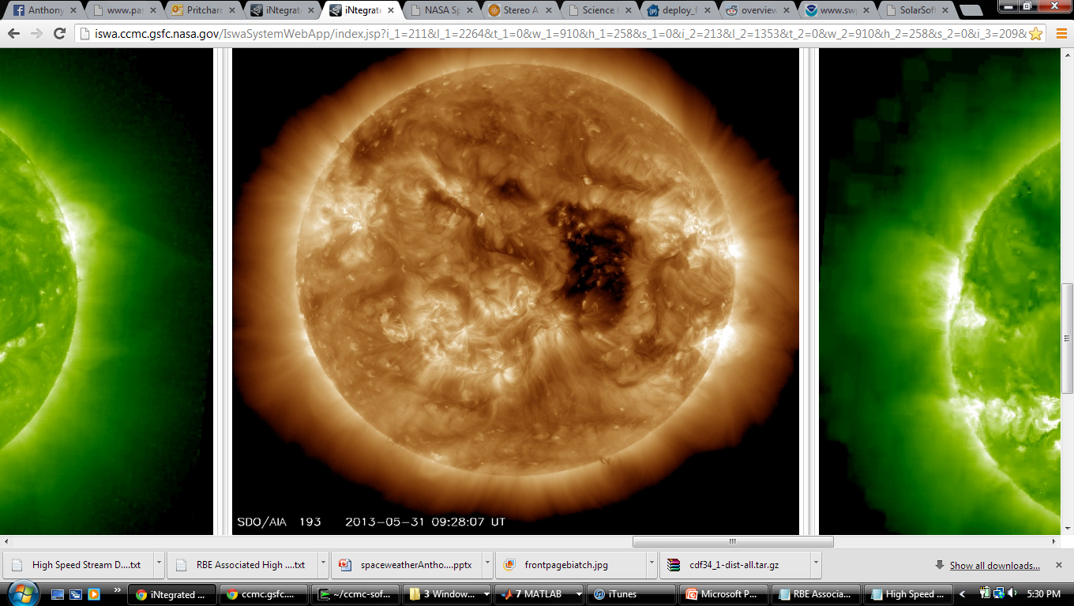
Understanding Solar Energetic Particles and High Speed Solar Wind Streams
Anthony Pritchard
NASA GSFC: CCMC/SWRC
August 7, 2013

Slide 2
Solar Energetic Particles (SEPs)

Slide 3
Summary of Characteristics
Relativistic protons, etc. emitted from powerful flares and CMEs
Widening of longitudinal extent by CMEs & magnetic connectivity
Measured in pfu or pfu/MeV by STEREO, SOHO/COSTEP, GOES
Consequences: Astronauts in EVA, Satellite memory/operation/imagery, Radio blackout, Navigation

Slide 4
Coronal Holes and High Speed Streams (HSSs)

Slide 5
Physical Overview
Coronal Holes
Dim regions of “open” magnetic field lines
High Speed Streams
Plasma outflow from coronal holes
Corotating Interaction Regions
Boundary of HSS where interactions (currents / mag. field differences) occur with background solar wind

Slide 6
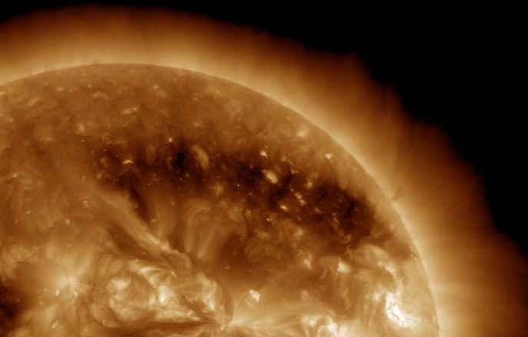
Physical Overview
Coronal Holes

Slide 7
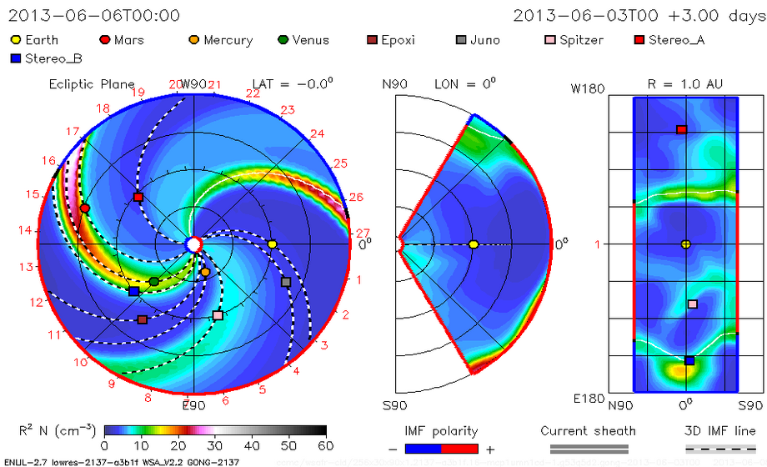
Physical Overview
HSS / CIR

Slide 8
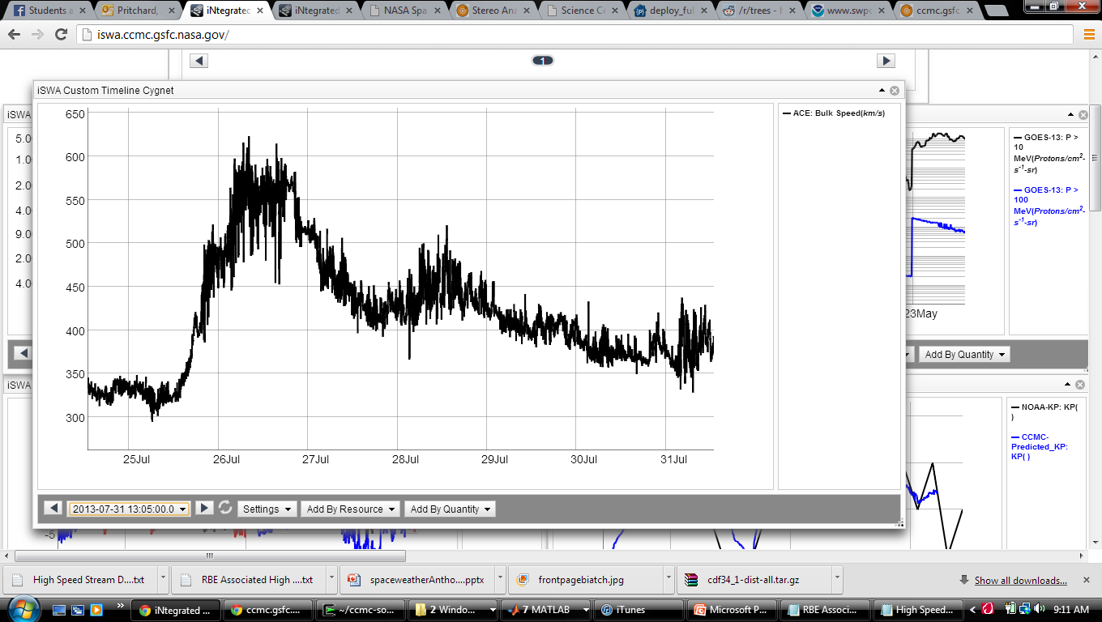
Space Weather Impacts
HSS: Geomag. storms, Magnetopause compression, Radiation belt electron enhancement, ESDs, Atmospheric changes, Comm.

Slide 9
Space Weather Impacts
Tasks:
SEPs:
Watch for signatures after flare
Send SEP alert
HSSs:
Anticipate impact using ENLIL
Send alerts for K_{p}, standofff distance, or geomagnetic storm

Slide 10
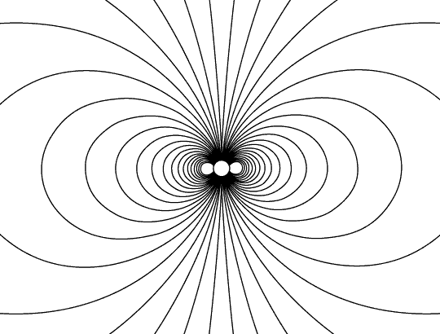
Using a particle tracer to investigate high latitude ionosphere-mesosphere bulk oxygen ion (O⁺) outflows
Anthony Pritchard

Slide 11
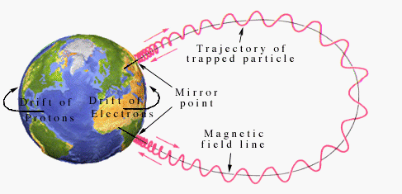
Introduction
Project Goals:
Incorporate any CCMC magnetosphere model output into simulator via Kameleon
Provide the finalized particle tracing tool to CCMC
Accurately and efficiently trace groups of ions with high resolution
Research conditions for escape and extrapolate throughout magnetosphere

Slide 12
Introduction
Summary of Accomplishments
Graphical representation of Earth & its simplified magnetic dipole field lines
Gyro, bouncing, and drift motion (output shows the expected E×B drift)
Ion energization/escape and conditions affecting escape
Collision simulations, gravity, changing dt
Kameleon compiled on Cygwin on my laptop

Slide 13
Introduction
Present Issues
Kameleon
Creating a wrapper
Matlab/Octave/Python
Optimizing efficiency
Integrator efficiency investigation

Slide 14
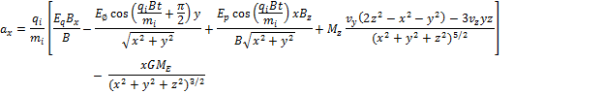
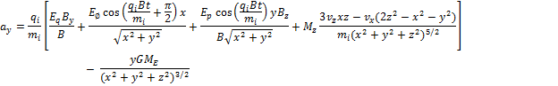
Solution Process

Slide 15
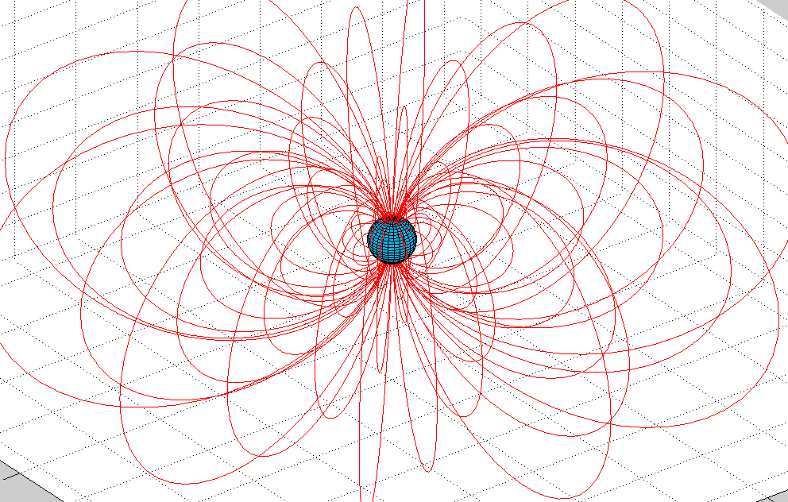
Presentation of Results Dipole Magnetosphere Model

Slide 16
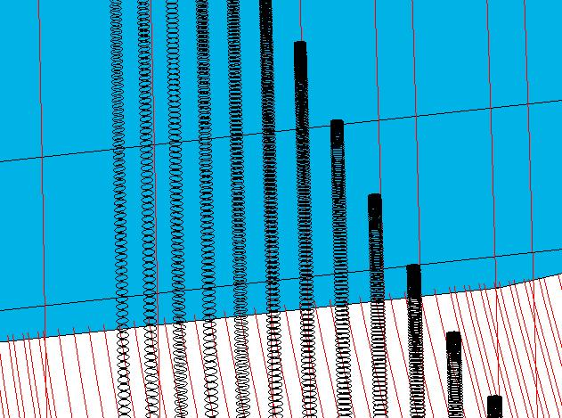
Presentation of Results

Slide 17
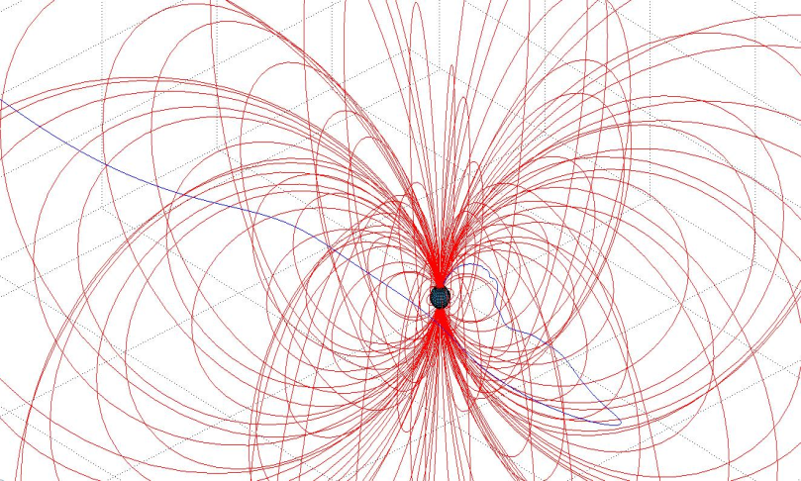
Presentation of Results

Slide 18
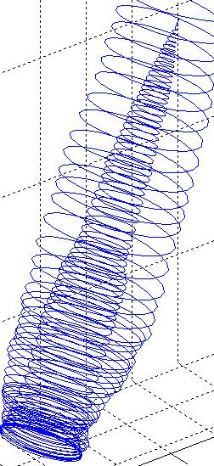
Presentation of Results

Slide 19
Presentation of Results

Slide 20
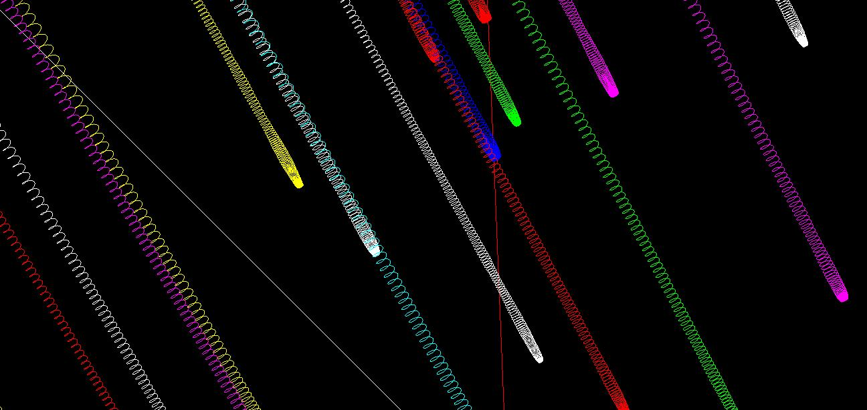
Presentation of Results

Slide 21
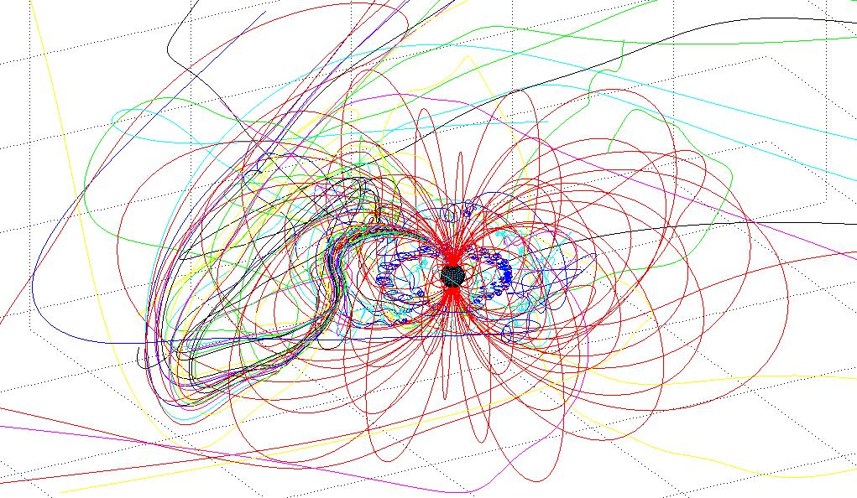
Presentation of Results

Slide 22
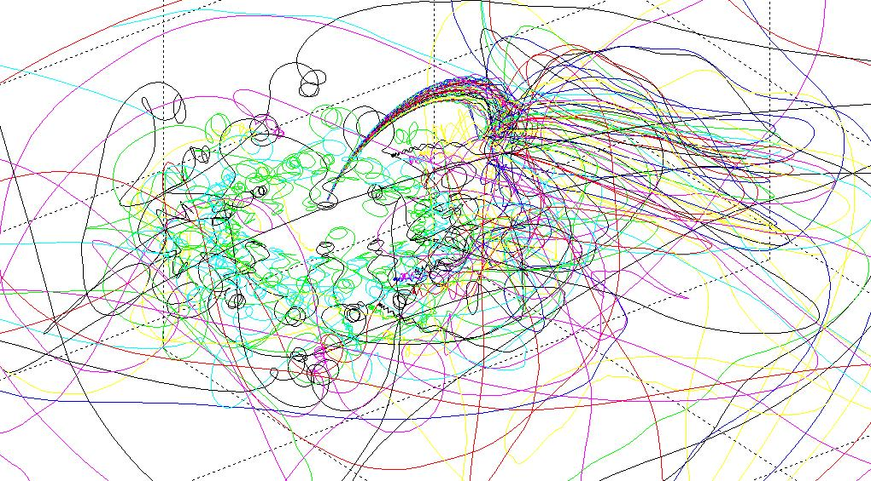
Presentation of Results

Slide 23
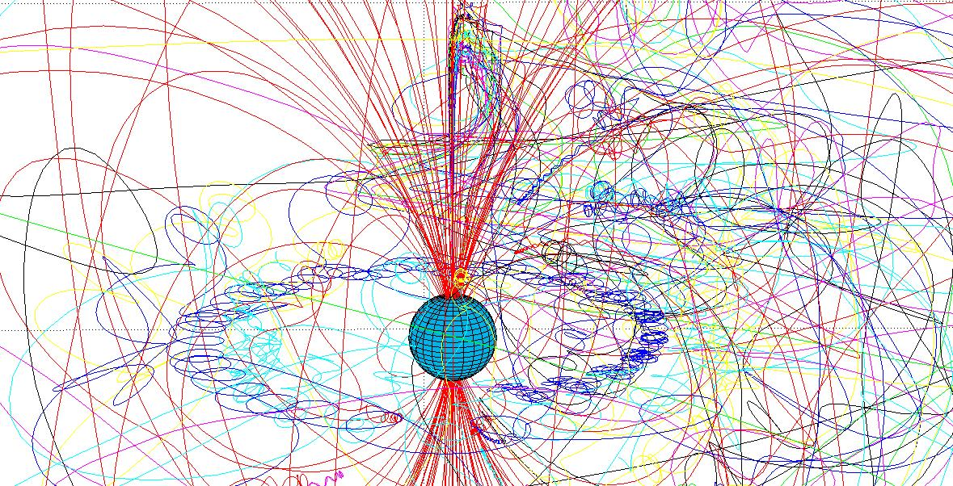
Presentation of Results

Slide 24
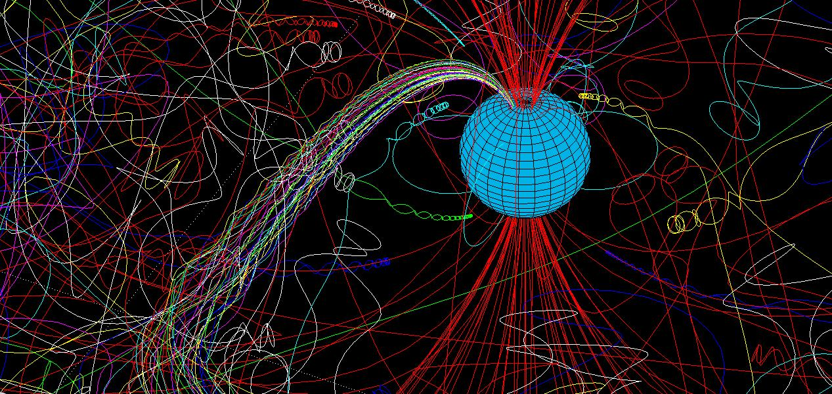
Presentation of Results

Slide 25
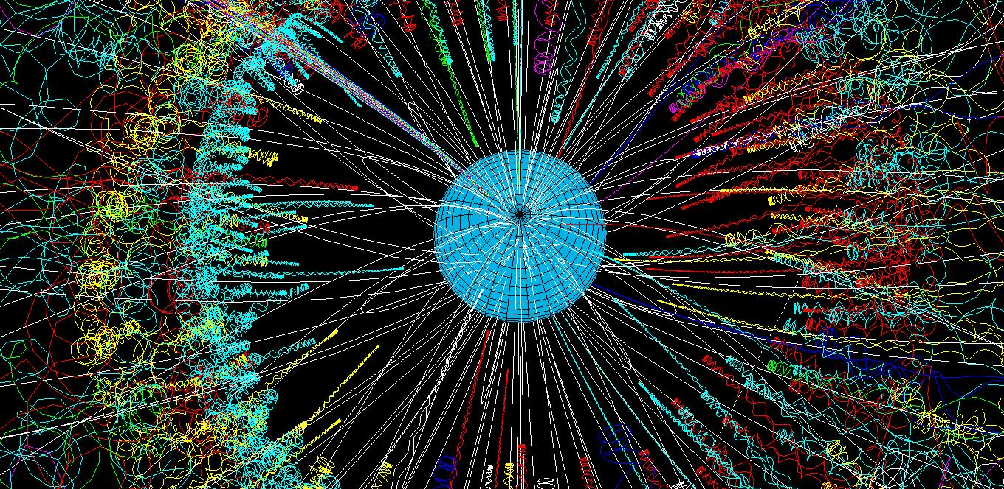
Presentation of Results

Slide 26
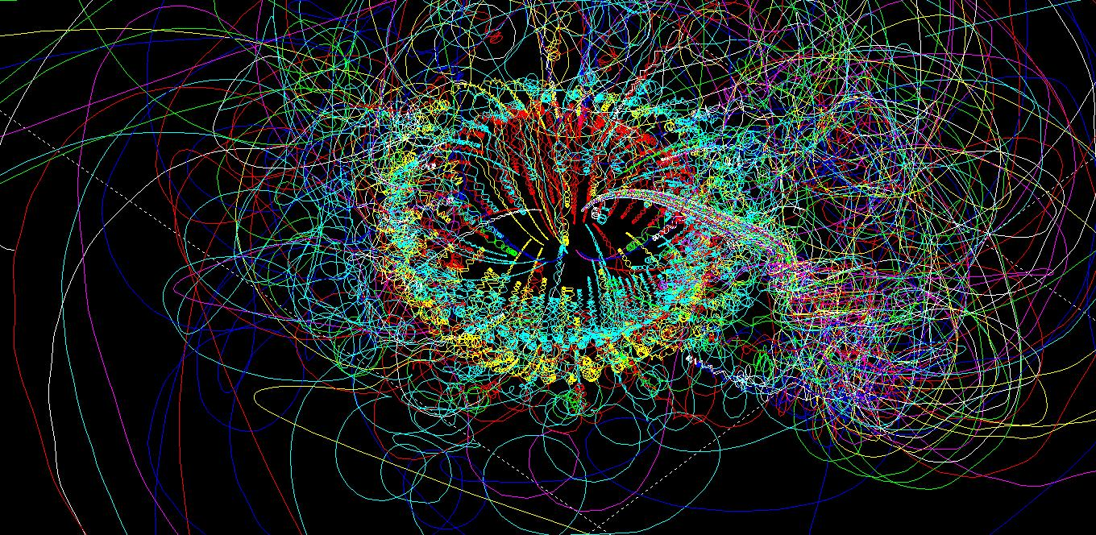
Presentation of Results

Slide 27
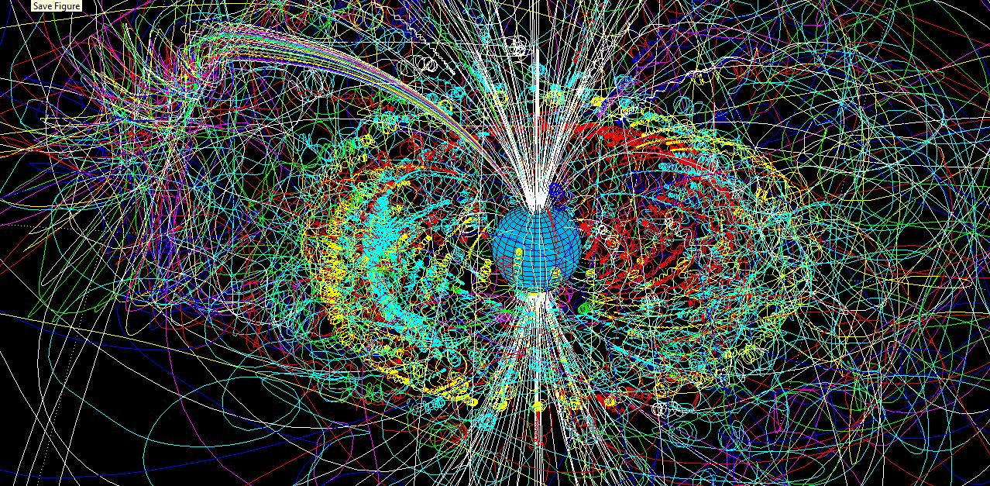
Presentation of Results

Slide 28
Current Goals
More realistic collisions
CCMC Magnetosphere
More low altitude effects (neutral winds, etc.)
More practical energizing E-fields
Model validation

Slide 29
Internship Summary
Completed Space Weather Bootcamp
Forecasted space weather in real time
Analyzed CMEs
Sent out alerts and daily/weekly logs
Gave daily tag-ups
Performed research which was relevant to both the internship & my Master’s thesis
Developed/improved a viable research tool
Developed plans to continue research and model development collaboration with CCMC in a mutually beneficial agreement

Slide 30
Conclusions
Became a “Space Weather Forecaster I” and am now fluent in forecasting responsibilities
Gained familiarity with actual, physical particle motion as opposed to theoretical studies / abstract model development
Acquired knowledge necessary to appreciate the importance of space physics research & understanding the dynamics of magnetosphere

Slide 31
References
http://iswa.ccmc.gsfc.nasa.gov/
Sandro’s Flares and CMEs, http://ccmc.gsfc.nasa.gov/support/ SWREDI/FlaresCMEs_ATaktakishvilli.pdf
Leila’s Coronal Holes and High Speed Streams, http://ccmc.gsfc.nasa. gov/support/SWREDI/CH_HSS_MLeilaMays_201306.pdf
Rebekah’s Solar Energetic Particles (SEPs), http://ccmc.gsfc.nasa.gov/ support/SWREDI/Evans-SWREDIBootCamp2013-SEPLecture-FINAL.pdf
http://www-ssc.igpp.ucla.edu/personnel/russell/papers/896/
Introduction to Space Physics. Kivelson and Russel. ERAU Library

